Slide 1
Resume Upload in R2D2 Tool User Manual

Slide 2
Access R2D2 Resume Portal over Capgemini Network or VPN if you are accessing the link from Customer Site http://r2d2-tools.capgemini.com *Update Resume per the Template provided below **Use Chrome Browser to access the above link
Resume Template

Slide 3
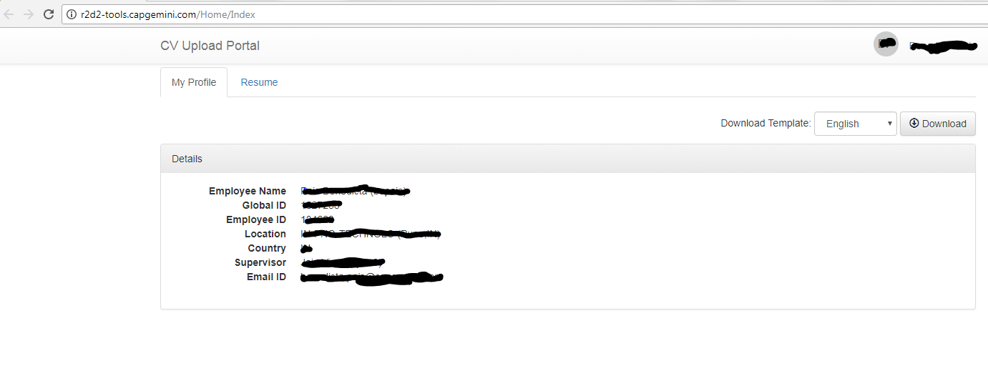
Click Here
Your Details will Appear here

Slide 4
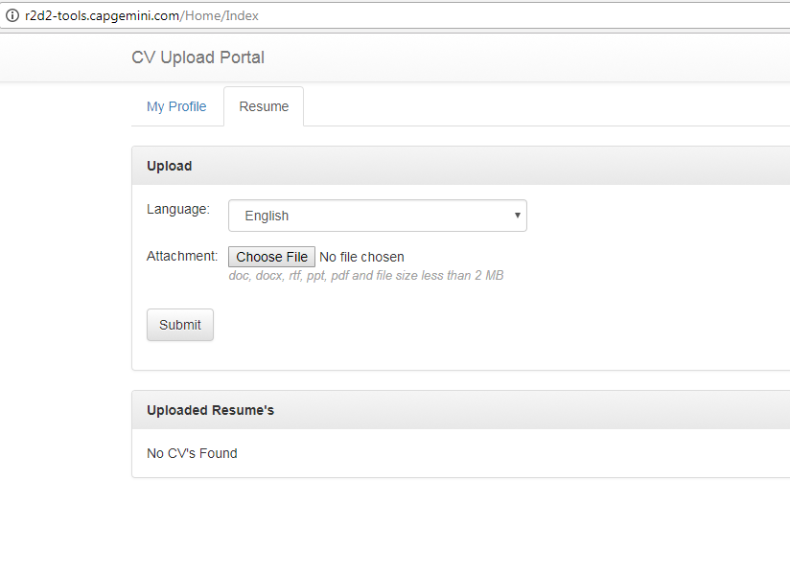
Pls Note: Resume has to be updated per the Template shared Pls save the file as “Name_Emp#” format Resume Document should not be more than 2 MB
Attach your updated resume and submit

Slide 5
Thank You

